Slide 1

VALUATION
OF INTUITIVE SURGICAL
PRESENTED BY-
GAYATRI BOMMISETTY
HARSHITHA J.S
UNDER THE GUIDANCE OF-
DR. SEONG BYUN

Slide 2
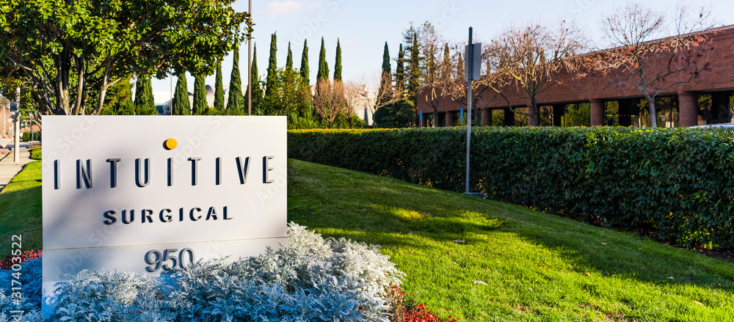
ABOUT COMPANY
AN INDUSTRY LEADER
Nasdaq: ISRG
Industry: Medical Appliances & Equipment
Founded: 1995; 28 years ago
Headquarters: Sunnyvale, California, U.S.
Key people
Gary S. Guthart- (CEO)
Jamie Samath- (CFO)
Products: da Vinci Surgical System (Xi, SP, X), Ion by Intuitive, Intuitive Hub, Services.

Slide 3
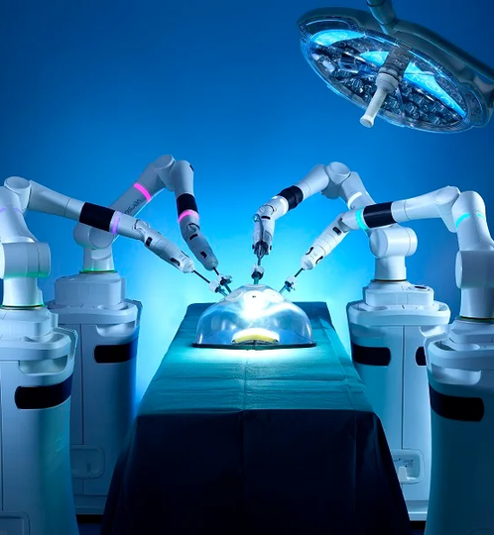
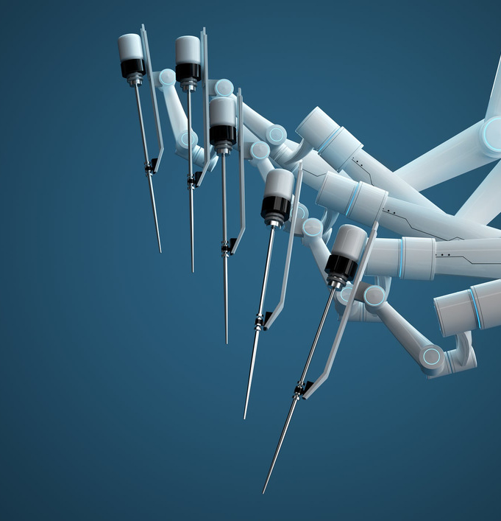
VALUES
Vision
Mission
We envision a future of
care that is less invasive
and profoundly better,
where diseases are
identified early and
treated quickly so
patients can get back
to what matters most. (Intuitive, 2023)
We believe that minimally invasive care is life-enhancing care. Through ingenuity and intelligent technology, we expand the potential
of physicians to heal without constraints.
(Intuitive, 2023)
INTUITIVE BY NUMBERS
1,800,000+ Procedures performed on da Vinci systems in 2022
1,200+ Da Vinci systems placed in 2022
1 3,000,000+ Procedures performed on da Vinci systems to Sep 2023
8,200+ Da Vinci systems in hospitals globally

Slide 4
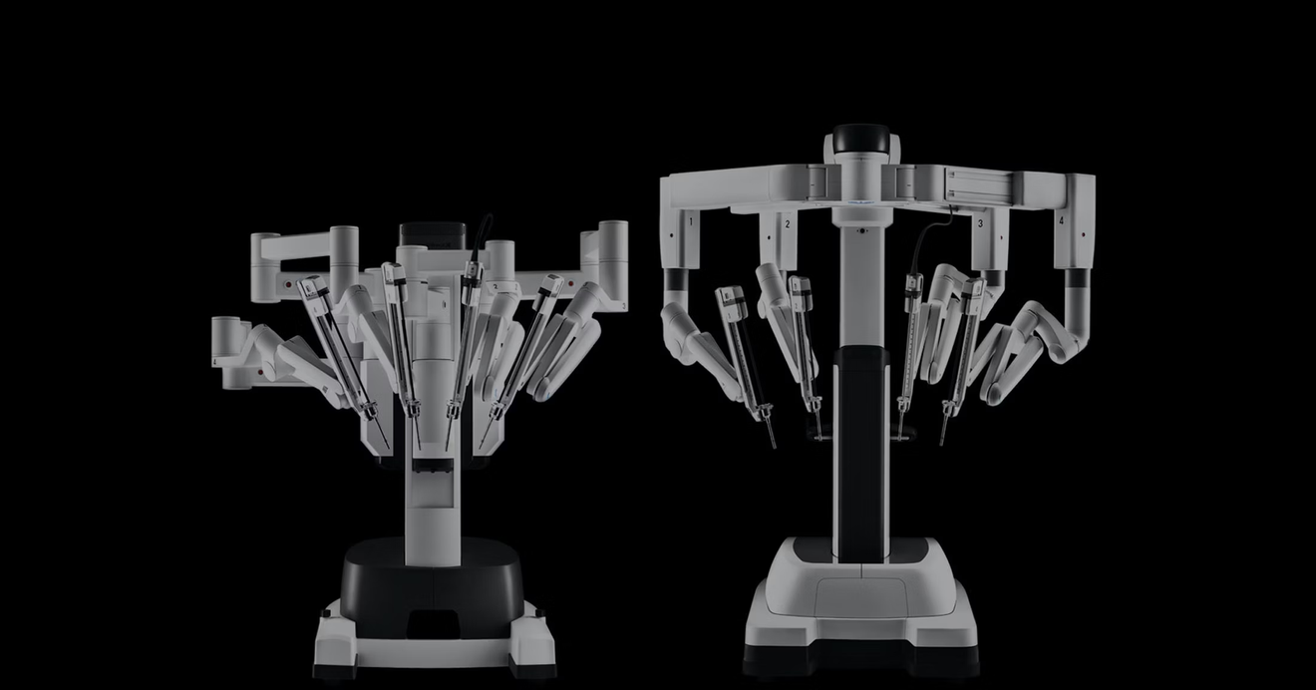
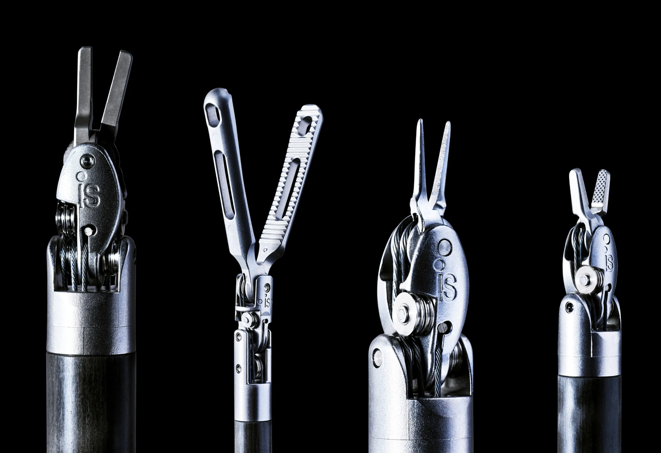
BUSINESS MODEL (B2B)
Intuitive Surgical "Razor and Blades" Model
Da Vinci system = the "razor"
Initial sale to hospitals at lower margins
Instruments, accessories, services = the "blades"
Recurring revenue from consumable products
High margins
Hospitals locked-in to keep buying blades after getting da Vinci system
Bulk of profits come from high-margin recurring "blade" revenue
Allows system adoption while generating lucrative revenue from installed base
This classic model creates system sales funnel and significant recurring "blade" profits. Intuitive makes thin margins on da Vinci "razor", big profits on recurring instruments and accessories "blade" sales.
.

Slide 5
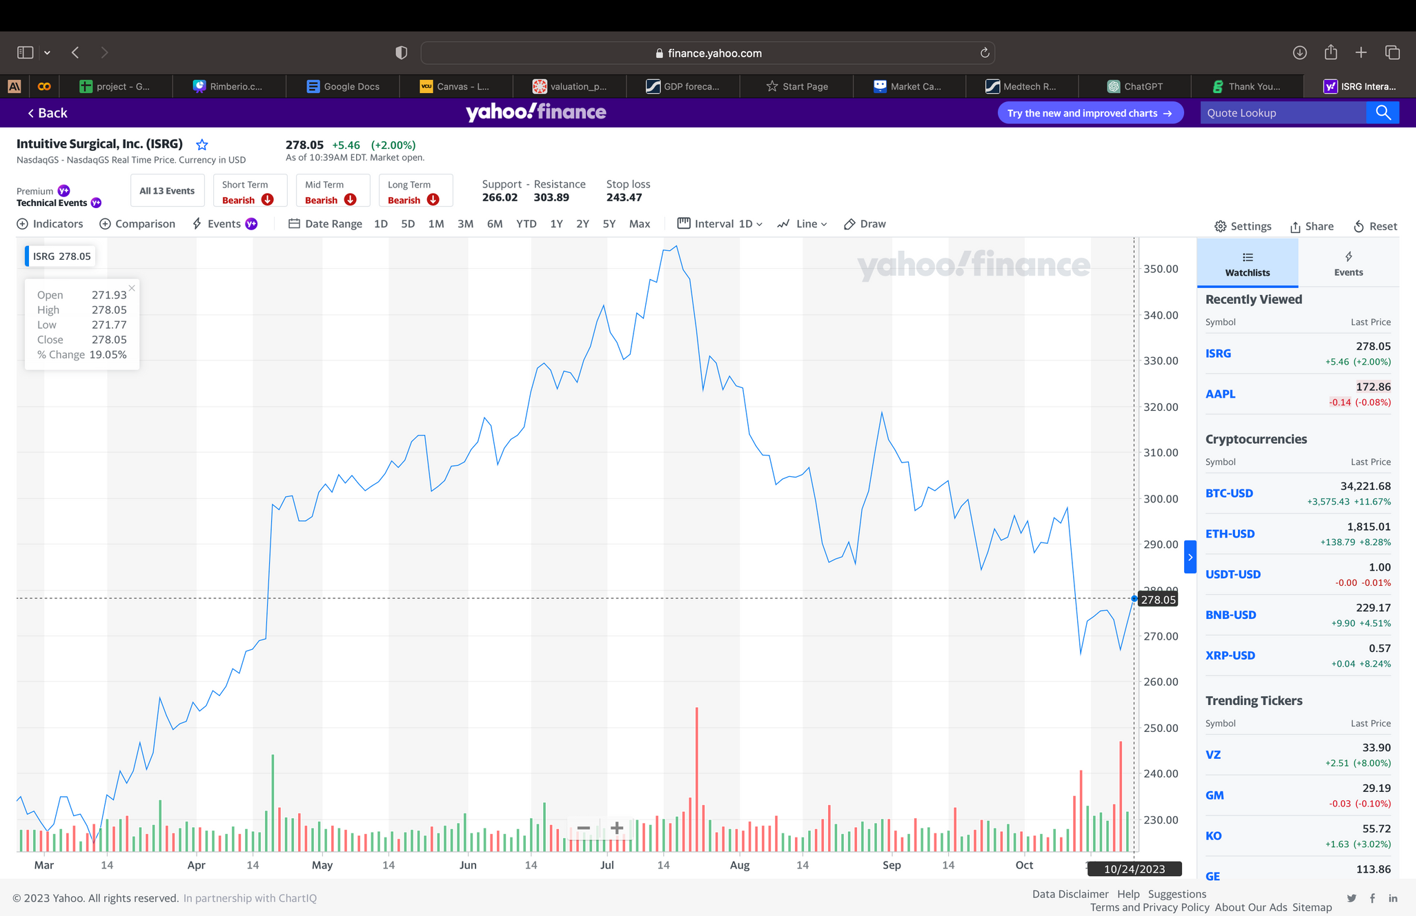
CURRENT MARKET STANDINGS
Revenue- US$6.22 billion (2022)
Operating income- US$1.58 billion (2022)
Net income- US$1.32 billion (2022)
Total assets- US$12.97 billion (2022)
Total equity- US$11.11 billion (2022)
Number of employees- 12,120 (December 2022)
Dividend Yield- 0.19%
Website- intuitive.com

Slide 6
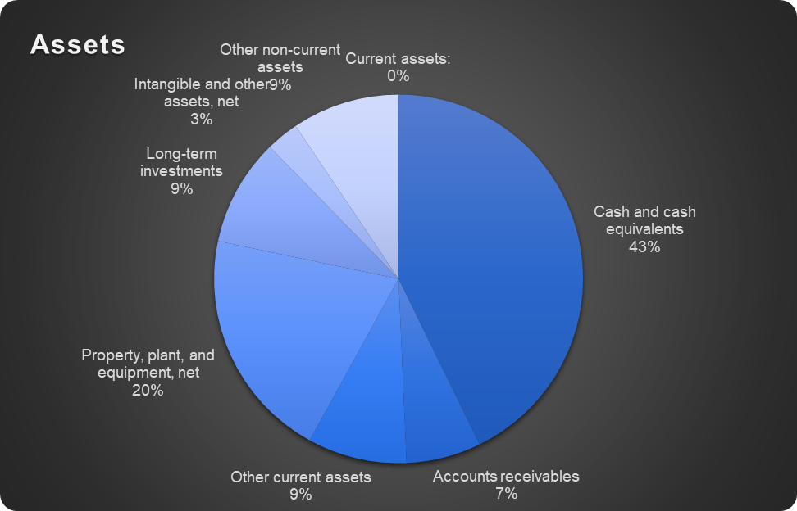
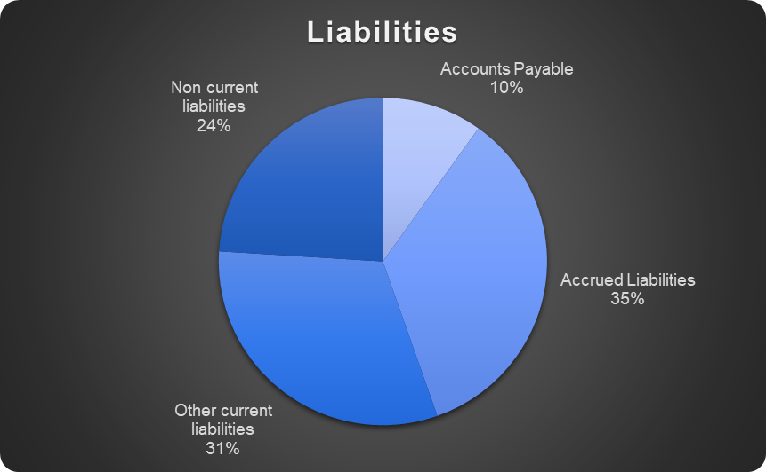
COMPANY FINANCIALS

Slide 7
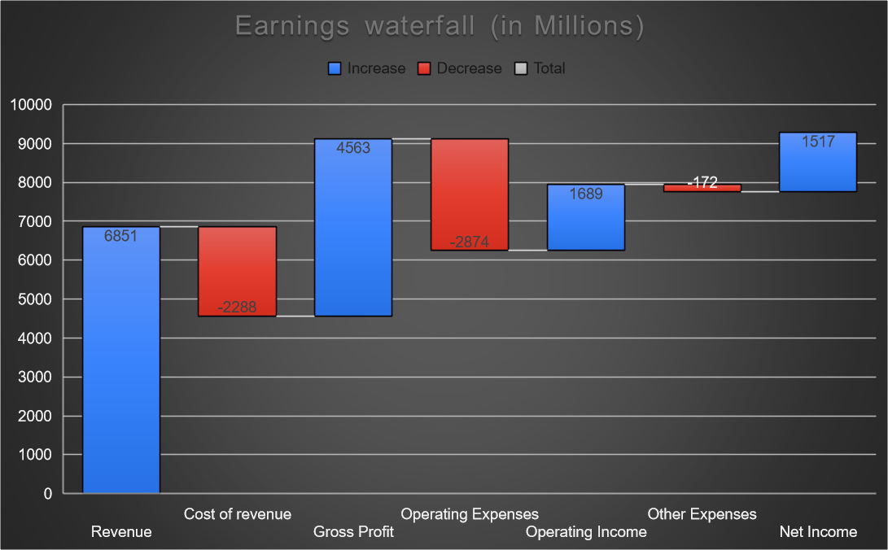
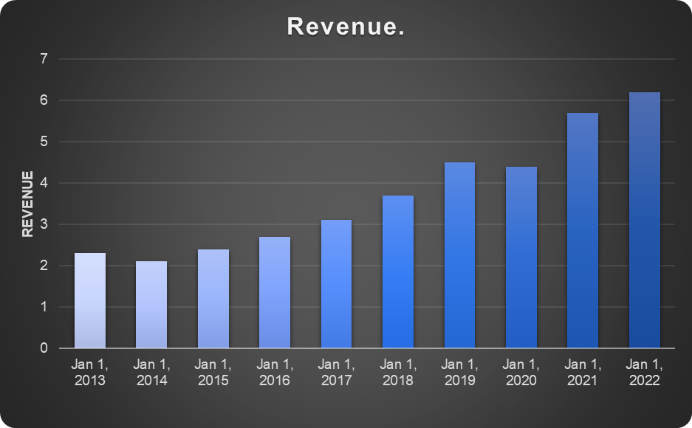
COMPANY FINANCIALS
The U.S. medical devices market size was valued at USD 192.78 billion in 2023 and intutive have a share of 55.41%
Its operating margin of 24.34% is better than 88.19% of 830 companies in the Medical Devices & Instruments industry

Slide 8
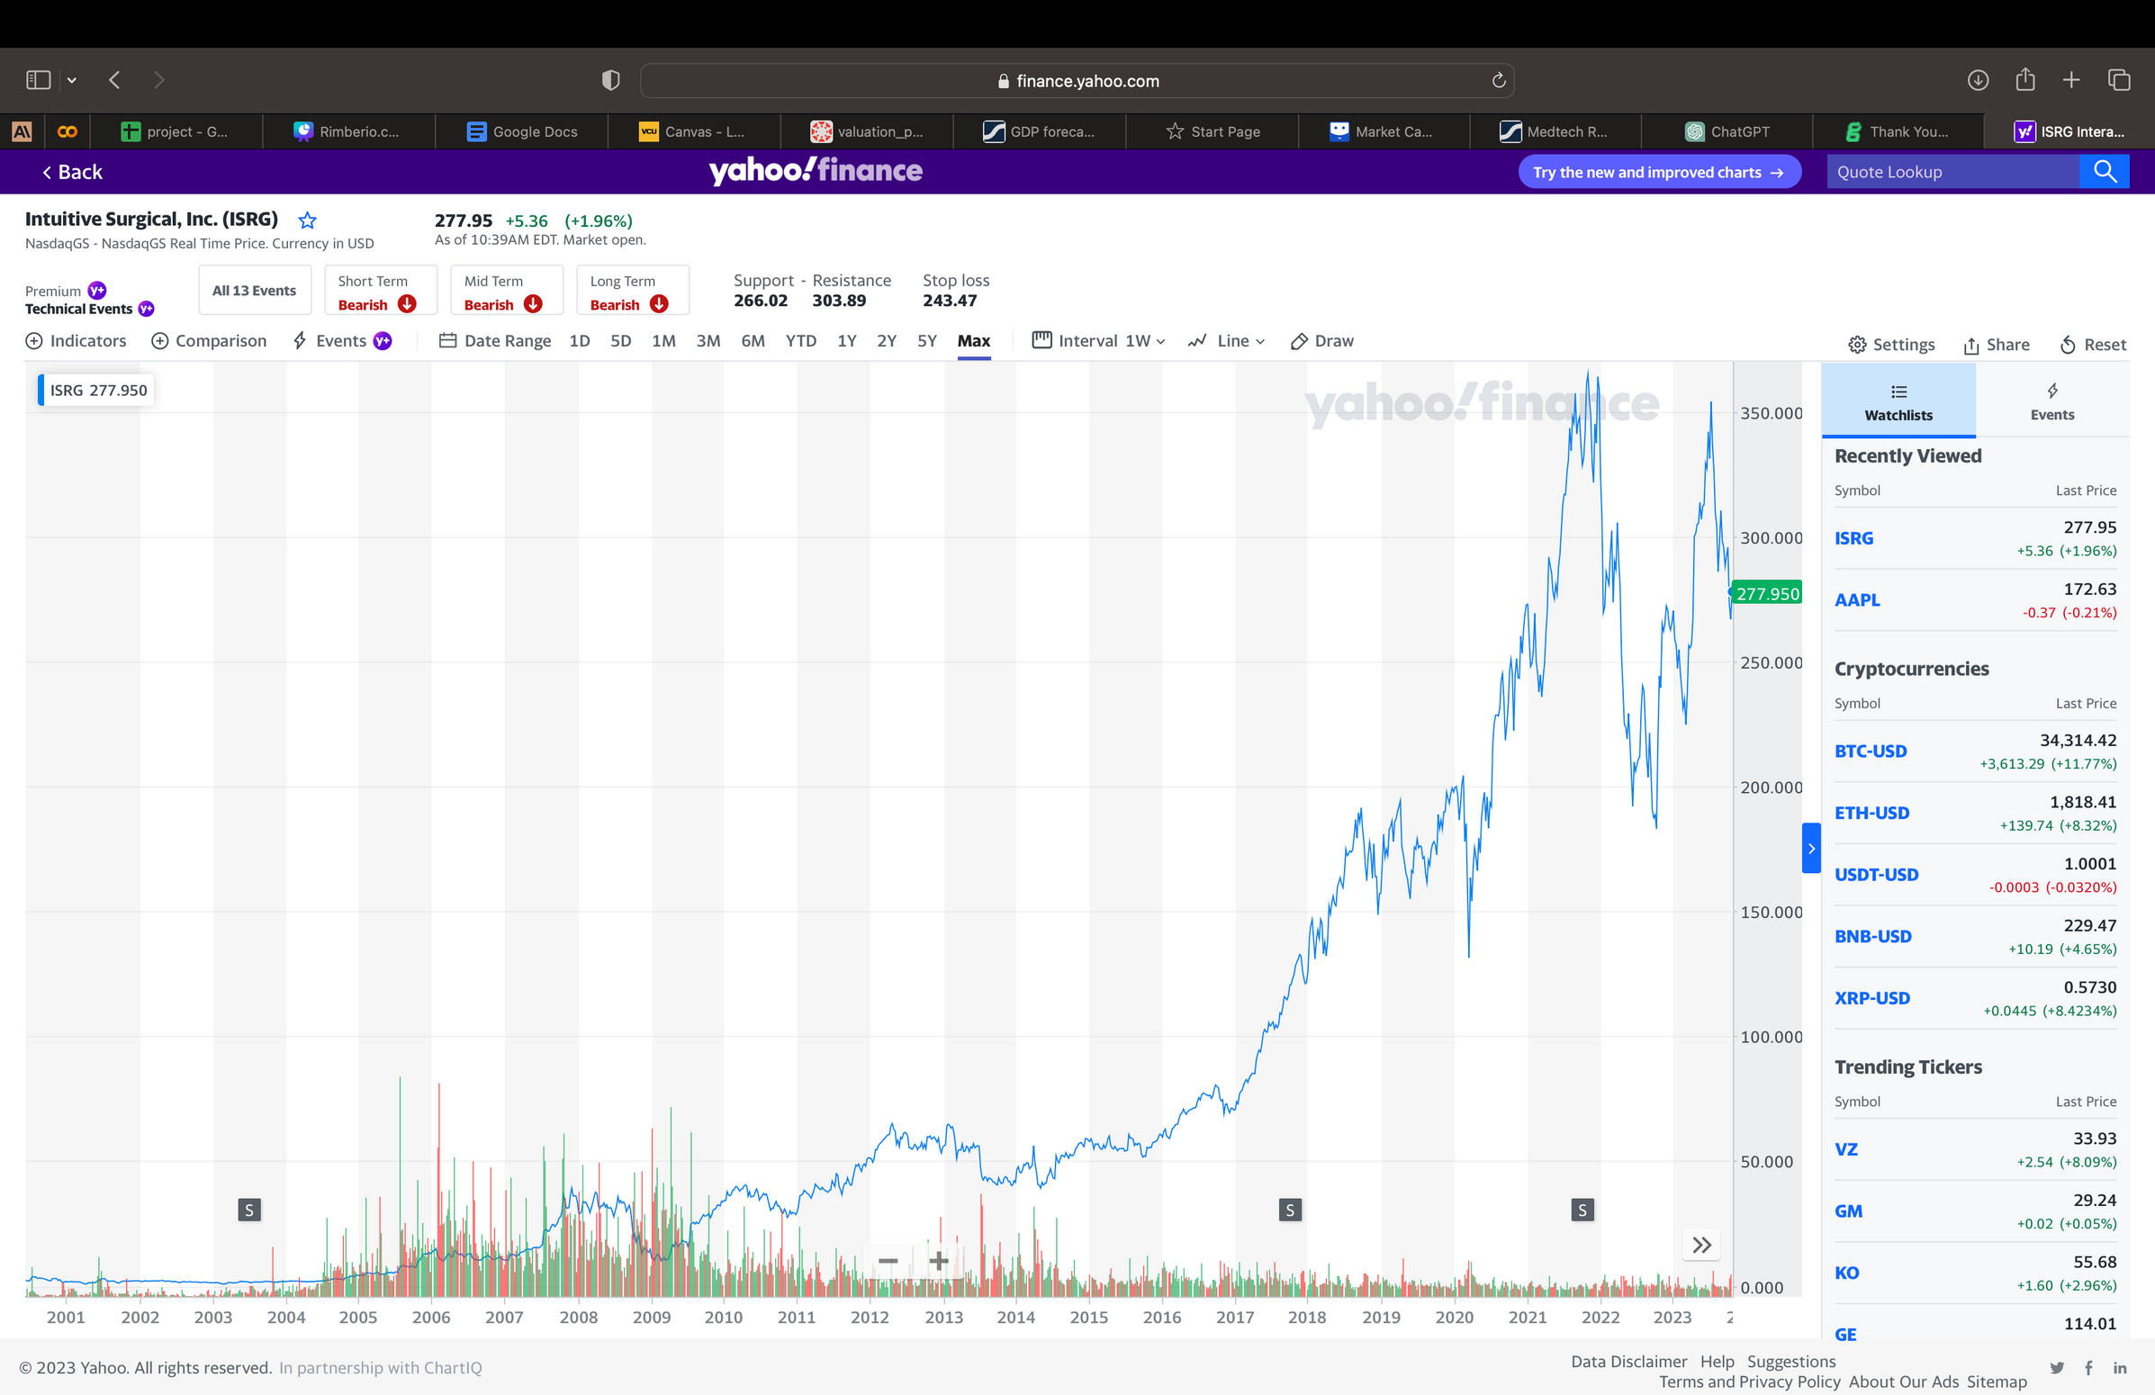
RECENT STOCK PRICE AND PERFORMANCE
Previous Close- 272.59
52 Week Range- 222.65 - 358.07
Avg. Volume- 1,784,185
Market Cap- 97.693B
Beta (5Y Monthly)- 1.30
PE Ratio (TTM)- 69.83
EPS (TTM)- 3.98
Earnings Date
Jan 22, 2024 - Jan 26, 2024
Forward Dividend & Yield
N/A (0.19%)
Ex-Dividend Date
N/A
1y Target Est- 332.76

Slide 9
Industry comparison
1
MARKET SHARE
The U.S. medical devices market size was valued at USD 192.78 billion in 2023 and intutive have a share of 55.41%
RESEARCH AND DEVELOPMENT
The U.S. medical devices R&D was valued at USD 23.4 billion in 2023 and intutive have a share of
4% .

Slide 10

1
COMPARABLE COMPANIES ANALYSIS

Slide 11
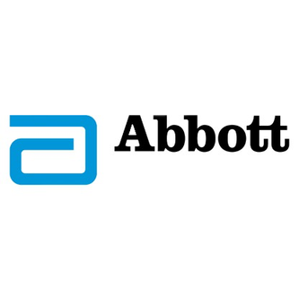

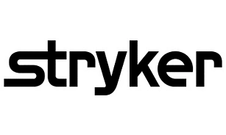
COMPETITORS
ABBOTT LABORATORIES
STRYKER
JOHNSON & JOHNSON
STOCK PRICE: ABT (NYSE) $94.99
AS OF SEP 2023, REVENUE- 10.14B
NET INCOME- 1.44B
DILUTED EPS- 0.82
NET PROFIT MARGIN- 14.16%
OPERATING INCOME- 1.68B
STOCK PRICE: SYK (NYSE) $264.11
REVENUE- 5B
Net income- 738M
Diluted EPS- 1.93
Net profit margin- 14.77%
Operating income- 1.04B
STOCK PRICE: JNJ (NYSE) $151.36
REVENUE- 21.35B
NET INCOME- 26.03B
DILUTED EPS- 10.21
NET PROFIT MARGIN- 121.91%
OPERATING INCOME- 5.9B

Slide 12
WHY?
All belong to medical device industry and offer products/services related to surgical procedures
All the companies have demonstrated steady revenue growth over the past several years
All the companies have relatively similar profitability levels and operating margins
Each company invests significantly in R&D and new product development in the medical device space

Slide 13
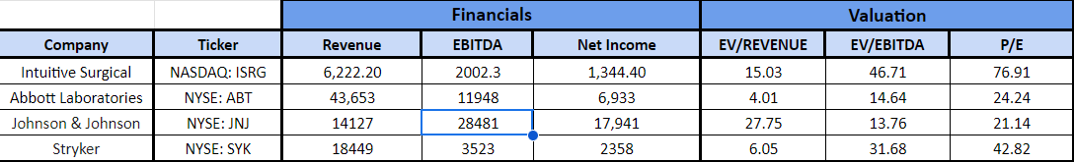
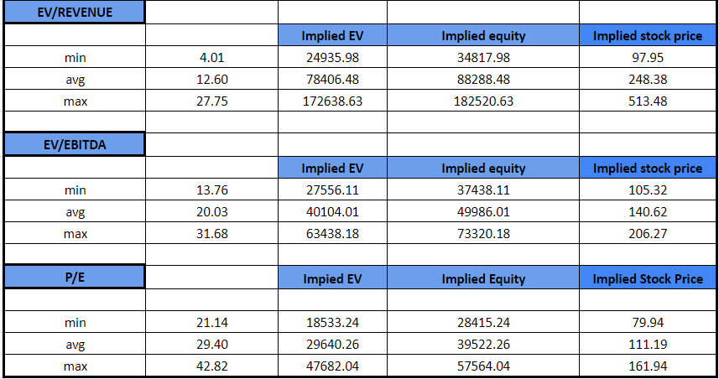
COMPARATIVE ANALYSIS

Slide 14
2
PRECEDENT TRANSACTIONS ANALYSIS

Slide 15



MERGER AND ACQUISITION
ABIOMED
SUMMIT HEALTH
SIGNIFY HEALTH
FOUNDED: 2017
REVENUE: 0.8 BILLION USD
MARKET CAP- 8.93 B
FOUNDED: 1981
REVENUE: 1.032 BILLION USD
MARKET CAP- 17.181B
REVENUE: 2 BILLION USD
MARKET CAP- 17.181B

Slide 16
WHY?
Abiomed, Summit Health, Signify Health are the companies taken for performing precedent transaction analysis as they have under gone mergers and acquisitions recently in the year 2022 by Johnson & Johnson,VillageMD, CVS Health respectively
. The company intuitive surgical had gone for IPO in 2000 and taking companies at the time IPO is not realistic.

Slide 17
PRECEDENT TRANSACTIONAL ANALYSIS
S.No | 1 | 2 | 3
Company | Abiomed | Summit Health | Signify Health
Acquirer name | Johnson & Johnson | VillageMD | CVS Health
Deal Value | $16600m | $8900m | $8000m
Date | Nov, 2022 | Nov, 2022 | Sep, 2022
Merger/acquistion | Acquisition | Acquisition | Acquisition
#shares outstanding at Acquistion | 45347.4 | 22088888.9 | 176666.7
Equity | 1,539,787 | 27,070,000 | 859,100
Total debt | 127,201 | 180,223,000 | 337,100
Cash | 182,335 | 12,089,000 | 461,600
EV | 1,484,653 | 195,204,000 | 734,600
LTM Revenue | 543,070 | 21,808,000 | 742,300
LTM EBIT | 124,044 | 5,944,000 | -602,400
LTM Deprecation | 13,344 | 6,814,000 | 52,800
LTM EBITDA | 137,388 | 12,758,000 | -549,600
EV/Revenue | 2.73 | 8.95 | 0.99
EV/EBIT | 11.97 | 32.84 | -1.22
EV/EBITDA | 10.81 | 15.30 | -1.34

Slide 18

3
DISCOUNTED CASH FLOW(DCF)

Slide 19
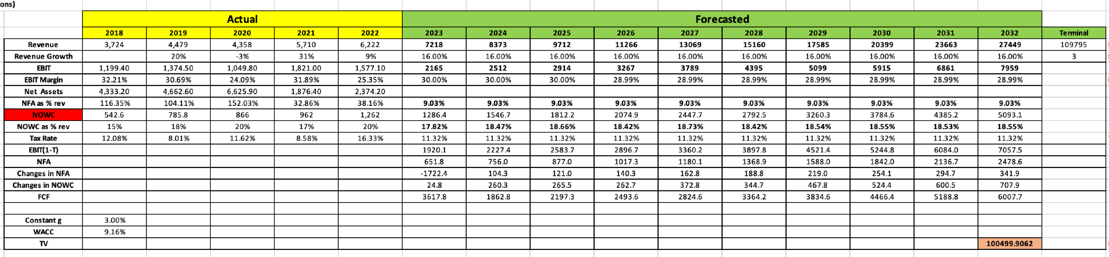
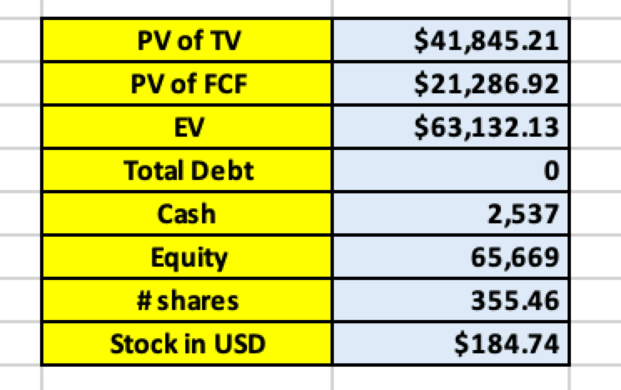
BASELINE

Slide 20
ASSUMPTIONS
S.NO | ASSUMPTION
1 | Revenue Growth rate | Mckinsey analysts estimated 13-19% and we took average
2 | EBIT margin | Average
3 | NFA as % of revenue | Industry
4 | NOWC as %of Revenue | Average of 5 years
5 | Tax Rate | Income statement calculated average
6 | Constant Growth rate | GDP

Slide 21
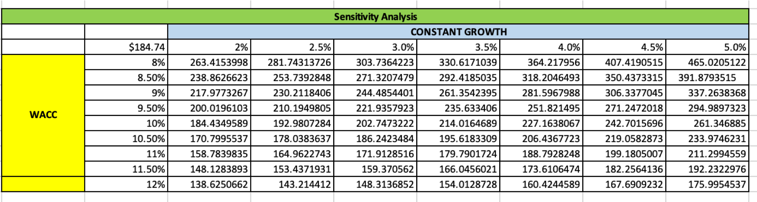
SENSITIVITY ANALYSIS
HIS $221.9 BILLION VALUATION SERVES AS THE CENTRAL ESTIMATE BASED ON THE COMPANY'S PROJECTED LONG-TERM GROWTH RATE OF 3.5% AND ESTIMATED COST OF CAPITAL OF 9.5%.
The table shows the valuation sensitivity to different constant growth and WACC assumptions around this 3.5% and 9.5% baseline.
If growth expectations decline or cost of capital rises, the valuation decreases from the $221.9 billion baseline.
Conversely, if the company can sustain higher growth or WACC decreases, the valuation increases from the baseline.

Slide 22
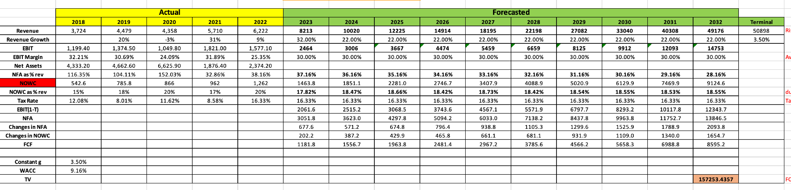
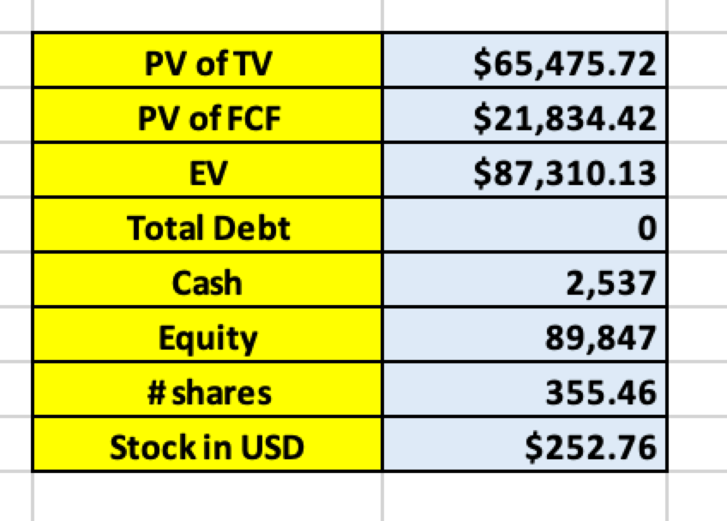
UPSIDE

Slide 23
ASSUMPTIONS
S.NO | ASSUMPTION
1 | Revenue Growth rate | Expect significant growth in the coming year as hospitals shift their focus away from COVID and invest more in minimally invasive surgeries. Intuitive Surgical appears to be the primary choice for them. While growth may taper off slightly after the initial post-COVID recovery, it will still remain robust due to the ongoing trend of hospitals prioritizing minimally invasive procedures.
2 | EBIT margin | Average
3 | NFA as % of revenue | The company won't need significant investments in the short term as hospitals seek more of their robotic systems after the pandemic, but they'll have to boost reinvestment for future growth.
4 | NOWC as %of Revenue | Average
5 | Tax Rate | 16.33% as a benchmark as the company's last year/ base year
6 | Constant Growth rate | GDP

Slide 24
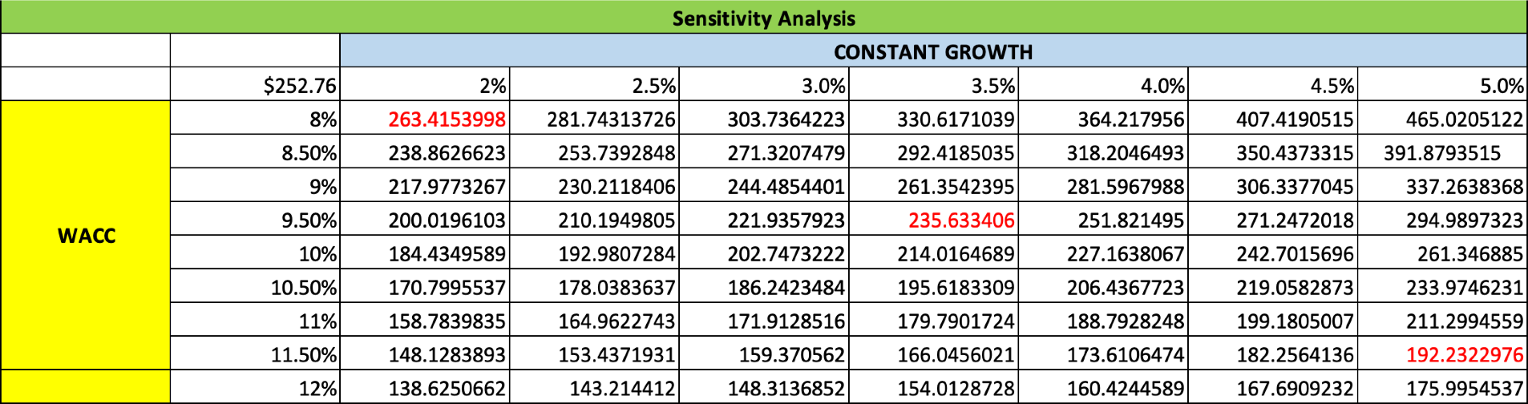
SENSITIVITY ANALYSIS
At a high growth rate of 5%, the valuation reaches $337.3 billion, almost 33% higher than the $252.7 billion.
The analysis shows the valuation has considerable upside potential if Intuitive Surgical can maintain high single digit revenue growth for the foreseeable future.
However, a deceleration in growth would negatively impact the valuation. At 2.5% growth, the valuation is 9% lower than the base case.

Slide 25
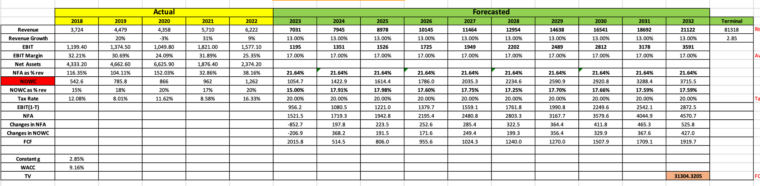
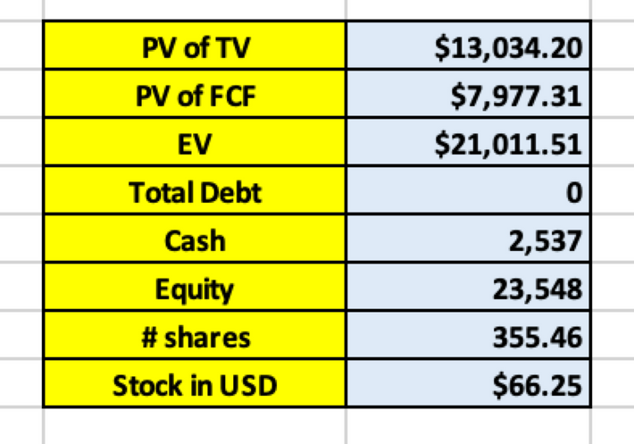
DOWNSIDE

Slide 26
ASSUMPTIONS
1
S.NO | ASSUMPTION
1 | Revenue Growth rate | Mckinsey analyst estimated 13%-19% | Mckinsey analyst estimated 13%-19% | Mckinsey analyst estimated 13%-19%
2 | EBIT margin | average of ebit margins from csi market | average of ebit margins from csi market | average of ebit margins from csi market
3 | NFA as % of revenue | average of past 4 year investment in R &d in industry | average of past 4 year investment in R &d in industry | average of past 4 year investment in R &d in industry
4 | NOWC as %of Revenue | average of past 5 years | average of past 5 years
5 | Tax Rate | Industry tax rate
6 | Constant Growth rate | it is lower limit of the US GDP RATE | it is lower limit of the US GDP RATE

Slide 27
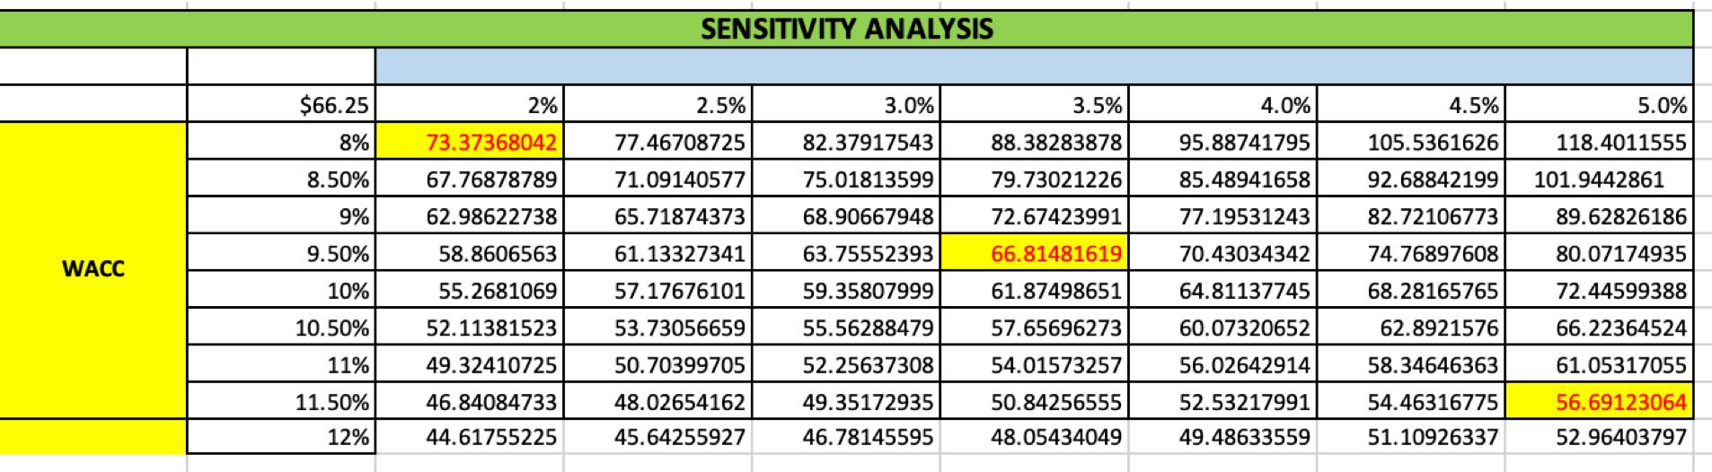
SENSITIVITY ANALYSIS
At a high growth rate of 5%, the valuation reaches $337.3 billion, almost 33% higher than the $252.7 billion base case.
The analysis shows the valuation has considerable upside potential if Intuitive Surgical can maintain high single digit revenue growth for the foreseeable future.
However, a deceleration in growth would negatively impact the valuation. At 2.5% growth, the valuation is 9% lower than the base case.

Slide 28
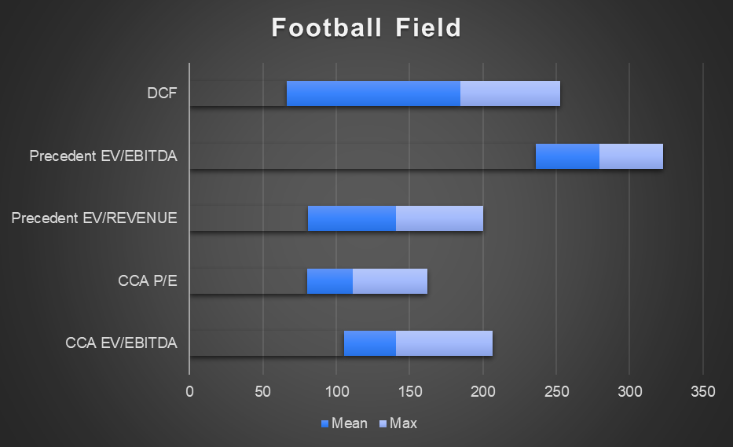

FOOTBALL FEILD
 | Min | Mean | Max
CCA EV/EBITDA | 105 | 35 | 66
CCA P/E | 80 | 31 | 51
Precedent EV/REVENUE | 80 | 60 | 60
Precedent EV/EBITDA | 236 | 43 | 43
DCF | 66 | 118 | 68

Slide 29

RECOMMENDATIONS
1
OVERVALUED BY 46%
The intrinsic value of one ISRG stock under the base case scenario is 184.74 USD. Compared to the current market price of 277.39 USD, Intuitive Surgical is overvalued by 46%.
2
INSIDER TRADING
During the last 12 months Intuitive Surgical Inc insiders have not bought any shares, and sold 79.4m USD worth of shares. The last transaction was made on Sep 14, 2023 by Ladd Amy L (Director), who sold 153k USD worth of ISRG shares.
 | SOLD | BOUGHT
0-3 MONTHS | 17.9 m USD | 0 USD
3-6 MONTHS | 17.9 m USD | 0 USD
6-9 MONTHS | 40.6 m USD | 0 USD
9-12 MONTHS | 3m USD | 0 USD
3
We suggest selling Intuitive Surgical because our valuation methods indicate that the stock's current market price is likely overvalued. This could be due to investors not fully recognizing the company's long-term reinvestment requirements and the premium associated with its dominant market position and strong cash position resulting from its debt-free strategy.

Slide 30
SOURCES
HTTPS://PAGES.STERN.NYU.EDU/~ADAMODAR/NEW_HOME_PAGE/DATACURRENT.HTML#RETURNS
https://csimarket.com/Industry/industry_Profitability_Ratios.php?ind=804
https://www.statista.com/statistics/276295/expenditure-on-research-by-us-and-european-medical-technology/
https://www.statista.com/statistics/755770/market-cap-growth-of-medtech-companies-in-us/

Slide 31
THANKYOU

